Slide 1
Unit 5
Load Balancing: Proxy arrays

Slide 2
Load balancing
Load balancing is a method for distributing tasks onto multiple computers.
For instance, distributing incoming HTTP request for a web application onto multiple web server. There are a few different ways to implement load balancing.
In computing, load balancing distributes workloads across multiple computing resources, such as computers, a computer cluster, network links, central processing units or disk drives
Load balancing aims to optimize resource use, maximize throughput, minimize response time, and avoid overload of any single resource. Using multiple components with load balancing instead of a single component may increase reliability through redundancy.
Load balancing usually involves dedicated software or hardware, such as a multilayer switch or a Domain Name System server process.

Slide 3
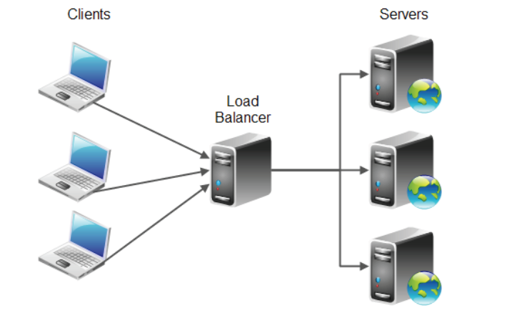
Basic principle of load balancing

Slide 4
Contd..
The primary purpose of load balancing is to distribute the workload of an application onto multiple computers, so the application can process a higher workload.
Load balancing is way to scale an application
A secondary goal of load balancing is often to provide redundancy in your application. That is if one server in cluster of servers fails, the load balancer can temporarily remove that server from the cluster and divide the load onto the functioning servers.
Having multiple servers help each other in this way is typically called redundancy.
When an error happens and the task is moved from the falling server to a functioning server, this is typically called failover.
A set of servers running the same application in cooperation is typically referred to as a cluster of servers.
The purpose of cluster is typically both of the above two mentioned goals, To distribute load onto different servers, and to provide redundancy/ failover for each other

Slide 5
Proxy arrays
Proxy arrays is a cluster of proxy server.
Proxy arrays for distributed caching enable multiple proxies to serve as a single cache.
Each proxy in the array will contain different cached URLs that can be retrieved by a browser or downstream proxy server.
Proxy arrays prevent the duplication of caches that often occurs with multiple proxy servers.
Through hash-based routing, proxy arrays route requests to the correct cache in the proxy array.
Proxy arrays also enable incremental scalability.
If we decide to add another proxy to your proxy array, each member’s cache is not invalidated.
Only 1/n of the URLs in each member’s cache, where n is the number of proxies in your array, will be reassigned to other members

Slide 6
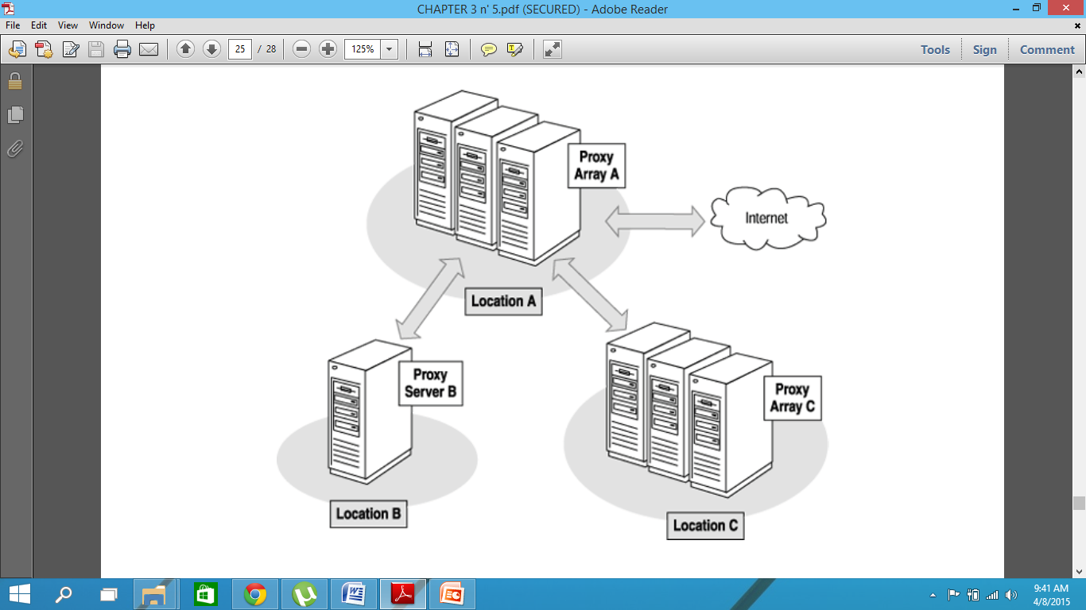
Working of proxy array

Slide 7
Unit 7
Security and System Administration Issues, Firewalls and Content Filtering

Slide 8
System Administrator
A system administrator, or sysadmin, is a person who is responsible for the upkeep, configuration, and reliable operation of computer systems; especially multi-user computers, such as servers.
The system administrator seeks to ensure that the uptime, performance, resources, and security of the computers he or she manages meet the needs of the users, without exceeding the budget.
To meet these needs, a system administrator may acquire, install, or upgrade computer components and software; provide routine automation; maintain security policies; troubleshoot; train and/or supervise staff; or offer technical support for projects.

Slide 9
jobs related to system administration
A database administrator (DBA) maintains a database system, and is responsible for the integrity of the data and the efficiency and performance of the system.
A network administrator maintains network infrastructure such as switches and routers, and diagnoses problems with these or with the behavior of network-attached computers.
A security administrator is a specialist in computer and network security, including the administration of security devices such as firewalls, as well as consulting on general security measures.
A web administrator maintains web server services (such as Apache or IIS) that allow for internal or external access to web sites. Tasks include managing multiple sites, administering security, and configuring necessary components and software. Responsibilities may also include software change management.
A computer operator performs routine maintenance and upkeep, such as changing backup tapes or replacing failed drives in a redundant array of independent disks (RAID). Such tasks usually require physical presence in the room with the computer, and while less skilled than sysadmin tasks, may require a similar level of trust, since the operator has access to possibly sensitive data.
A postmaster administers a mail server.
A Storage (SAN) Administrator can create, provision, add or remove Storage to/from Computer systems. Storage can be attached locally to the system or from a storage area network (SAN) or network-attached storage (NAS). The administrator can also create file systems from newly added storage.

